Slide 1
Report on Electrical Characterisation of 1-layer MoS2 thin film transistors under X-ray radiation (17/11-22/11)
The transistors were fabricated by Adrian Tamayo at the University of Strasbourg. The electrical characterization was performed by Mikhail Bandurist in collaboration with Ilaria Fratelli and professor Laura Basiricò at the University of Bologna.

Slide 2
Samples structure and characterization
MoS₂
Top contact / Bottom gate
Note: If you need, you can scratch the surface of the substrates to access the gate.
Au/Cr 45/3 nm
BCB layer 50 nm
SiO_{x} 278 nm
MEASUREMENTS
n-type semiconductor
Low stability in aire, storage in glove box
Electrical measurements were performed reaching V_{DS} = 1 V, and V_{GS} = -60 to 60 V
Delay 100 ms and ΔV_{GS} = 0.5 V
Si

Slide 3
Table (Samples 1-8)
Common features: • Batch 2 • No encapsulation • Thickness of SiO2 insulator layer = 278 nm
• Capacitance per unit area Ci = 0.0124 (uF/cm^2)
Sample_device | W (um) | L (um) | MoS2 thick (nm) | ON/OFF (#/10^6) | SS (V/dec) | Vth (V) | mu (cm^2/(V*s)) | Sensitivity per Volume (C/(Gy*m^3))
S1_d1 | 19.8 | 2.6 | 4.5±0.5 | 0.22 | 4.32±0.16 | -8.75±0.11 | 0.2156±0.0013 | No drain current
S1_d2 | 11.6 | 2.3 | 5.4±0.7 | 0.04 | 12.67±0.08 | 6.87±0.13 | 0.01684±0.00010
S1_d3 | 21.2 | 2.7 | 6.0±0.6 | 3.23 | 2.71±0.05 | -32.1±-.7 | 0.0049±0.0002 | No peaks, steps downwards
S1_d4 | 17.6 | 2.3 | 2.6±0.3 | 0.01 | 8.70±0.12 | 4.6±0.3 | 0.01091±0.00002
S1_d5 | 14.1 | 2.7 | 2.9±0.7 | No current | No current | No current | No current
S4_d1 | 13.6 | 2.3 | 2.4±0.3 | 11.30 | 2.85±0.04 | -43.0±0.6 | 0.478±0.012 | No drain current
S5_d1 | 21.8 | 2.3 | 8.9±0.9 | No current | No current | No current | No current
S5_d2 | 20.9 | 2.2 | 5.8±0.9 | 0.04 | 5.085±0.26 | -4.62±0.08 | 0.01113±0.00006
S5_d3 | 16.4 | 2 | 2.8±0.4 | No current | No current | No current | No current
S5_d4 | No data | No data | 3.1±0.5 | No current | No current | No current | No current
S6_d1 | 24.5 | 2.3 | 8.3±0.9 | 14.20 | 4.98±00.10 | -15.61±0.07 | 0.96±0.007 | No peaks, steps downwards
S6_d3 | 21.1 | 2.1 | 10.8±0.6 | No current | No current | No current | No current
S6_d5 | 14.7 | 2.1 | 6.3±0.6 | 20.70 | 4.66±0.10 | -6.30±0.10 | 0.26280±0.0014 | No peaks are seen
S7_d1 | 10 | 1.9 | 2.8±0.4 | 3.18 | 5.92±0.07 | -3.2±0.2 | 0.0483±0.0005 | No peaks are seen (only small steps downwards)
S7_d4 | 13.8 | 2.2 | 3.8±0.4 | 0.00 | 6.5±0.3 | -9.23±0.08 | 0.00919±0.00004
S7_d5 | 32.1 | 1.3 | 5.7±0.3 | No current | No current | No current | No current
S8_d1 | 8.2 | 2 | 6.2±0.6 | 0.02 | 9.57±0.12 | 10.76±0.16 | 0.2443±0.0016 | No peaks are seen

Slide 4
Table (Samples 9-14)
Common features: • Batch 2 • No encapsulation • Thickness of SiO2 insulator layer = 278 nm
• Capacitance per unit area Ci = 0.0124 (uF/cm^2)
Sample_device | W (um) | L (um) | MoS2 thick (nm) | ON/OFF (#/10^6) | SS (V/dec) | Vth (V) | mu (cm^2/(V*s)) | Sensitivity per Volume (uC/(Gy*cm^3))
S9_d2 | 20.6 | 2.4 | 7.8±0.7 | Not reliable | 4.03±0.03 | Not reliable | 0.028581272
S9_d3 | 39.6 | 2.2 | 10.8±1.4 | 0.82 | 4.19±0.05 | -14.14±0.09 | 0.784±0.006 | Short circuit
S10_d1 | 12.4 | 3 | 3.9±0.5 | No contact between the sample and the tips | No contact between the sample and the tips | No contact between the sample and the tips | No contact between the sample and the tips
S10_d2 | 16.6 | 2.6 | 2.6±0.3 | 0.50 | 10.2±1.0 | 22.3±0.8 | 0.0197±0.0006
S10_d3 | 27.8 | 3.3 | 8.7±0.4 | 0.21 | 2.54±0.05 | -28.37±0.08 | 0.713±0.004 | No drain current
S10_d5 | 14.4 | 3.2 | 8.0±0.5 | No current | No current | No current | No current
S10_d6 | 14.8 | 4.4 | 9.4±0.5 | 0.01 | 8.50±0.17 | -45.0±0.4 | 0.329±0.005 | Short circuit
S11_d1 | 14.8 | 3.3 | 3.6±0.4 | 0.00 | 13.9±0.10 | 20.2±0.7 | 0.0309±0.0008
S11_d3 | 8.6 | 2.9 | 9.2±0.8 | 6.44 | 3.66±0.07 | -25.02±0.9 | 0.3481±0.0017 | No sense
S12_d1 | 9.9 | 2.9 | 4.8±0.6 | No current | No current | No current | No current
S12_d2 | 13.2 | 3.1 | 2.4±0.3 | 0.07 | 6.50±0.09 | 5.1±0.3 | 0.1231±0.0019 | Too high VGate for reaching photoconductive gain (VGate=50V)
S12_d3 | 20 | 3.8 | 3.3±03 | 0.00 | 8.62±0.11 | -8.11±0.09 | 0.0677±0.0004 | (3.8±0.2)*10^11(VGate=30V) (3.1±1.0)*10^11 (VGate=40V) (-30±7)*10^11 (VGate=50V) – NEGATIVE SENSITIVITY!
S12_d4 | 18.5 | 3.1 | 4.8±0.3 | 1.08 | 6.411±0.004 | -10.20±0.10 | 0.0331±0.0003 | (-1164±73)*10^11 (VGate=50V) NEGATIVE SENSITIVITY!
S14_d1 | 20.1 | 3.5 | 4.8±0.6 | 9.18 | 4.18±0.11 | -10.31±0.10 | 0.353±0.003 | No signal is seen
S14_d2 | 15.5 | 3.2 | 2.4±0.3 | 15.80 | 2.83±0.03 | -42.1±0.5 | 0.288±0.006 | No signal is seen
S14_d3 | 21.1 | 3.7 | 3.3±0.3 | 12.10 | 3.58±0.03 | -13.22±0.05 | 0.1267±0.0003 | (6.5±0.7)*10^11 (VGate=50V)
S14_d4 | 16.4 | 3.2 | 4.8±0.3 | 15.70 | 2.67±0.03 | -55.3±0.7 | 0.274±0.007 | (-123±24)*10^11 (VGate=1V) NEGATIVE SENSITIVITY!

Slide 5
X-ray measurements conditions
X-ray tube with Be window.
Distance between the samples and the Be window ≈30 cm.
Height (both the Be window and the samples) ≈ 22.5 cm.
The samples were placed in the Nextron box with tips.
During all the measurements the Nextron box with the samples was covered by Al foil.
The gate voltage was applied in the range between -50V and +50V.

Slide 6
Common tendency in most samples
Long (up to 10 minutes) relaxation of the drain current, that could be caused by high concentration of traps in the active channel.
When the X-ray radiation is ON, IDrain starts to decrease more faster than when the radiation is OFF. The result is similar to steps that are directed downwards.
Only two samples have devices that perform positive peaks under X-rays: Sample12 (S12_d3) and Sample14 (S14_d1, S14_d3 and S14_d4).
Some samples have working transfer characteristics, however, they show no signal of any kind even at ITube=500uA.

Slide 7
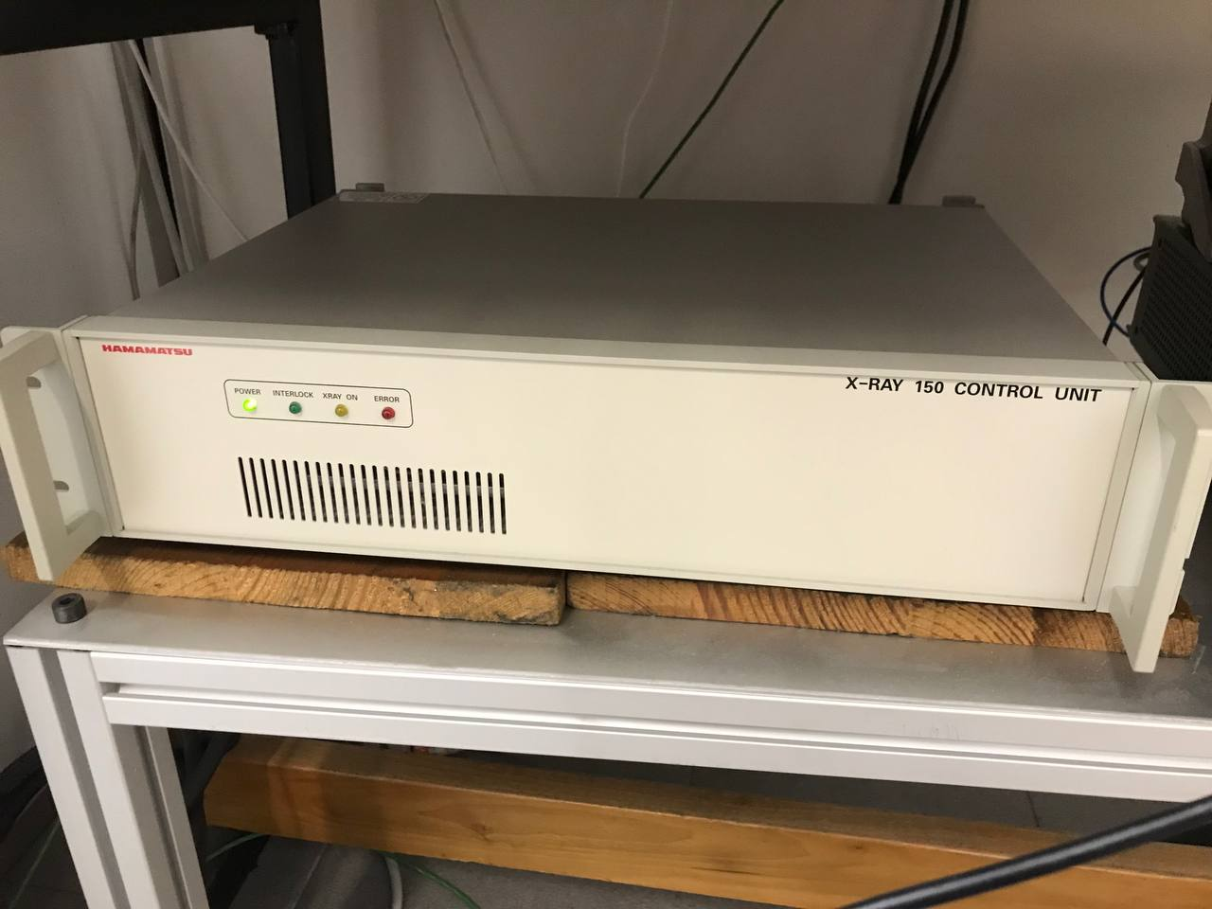
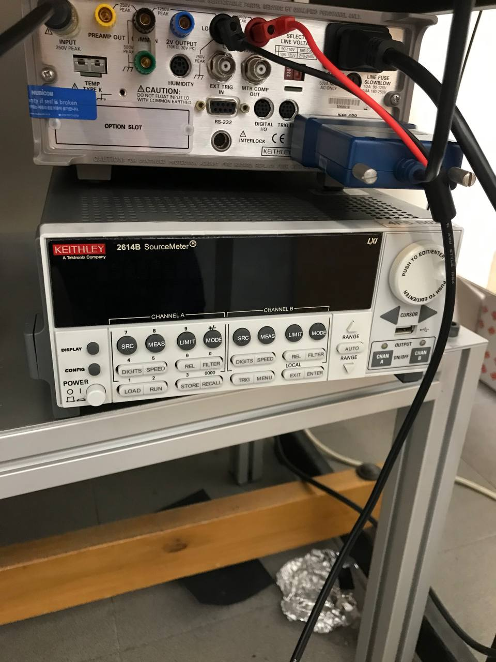
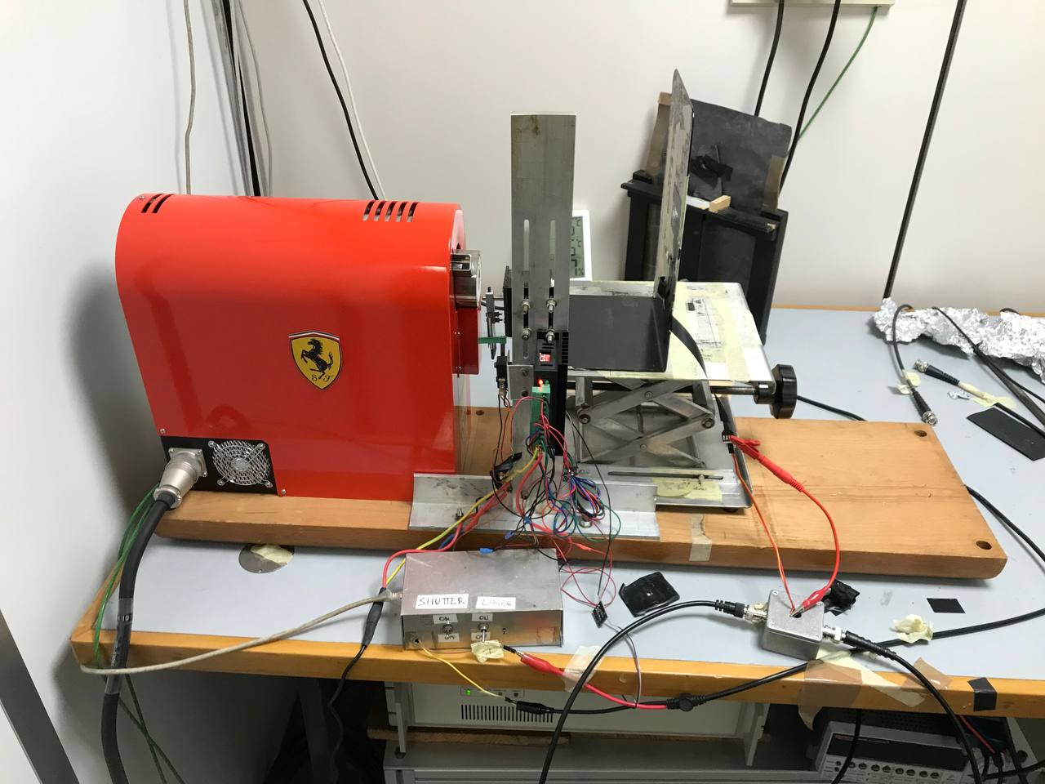
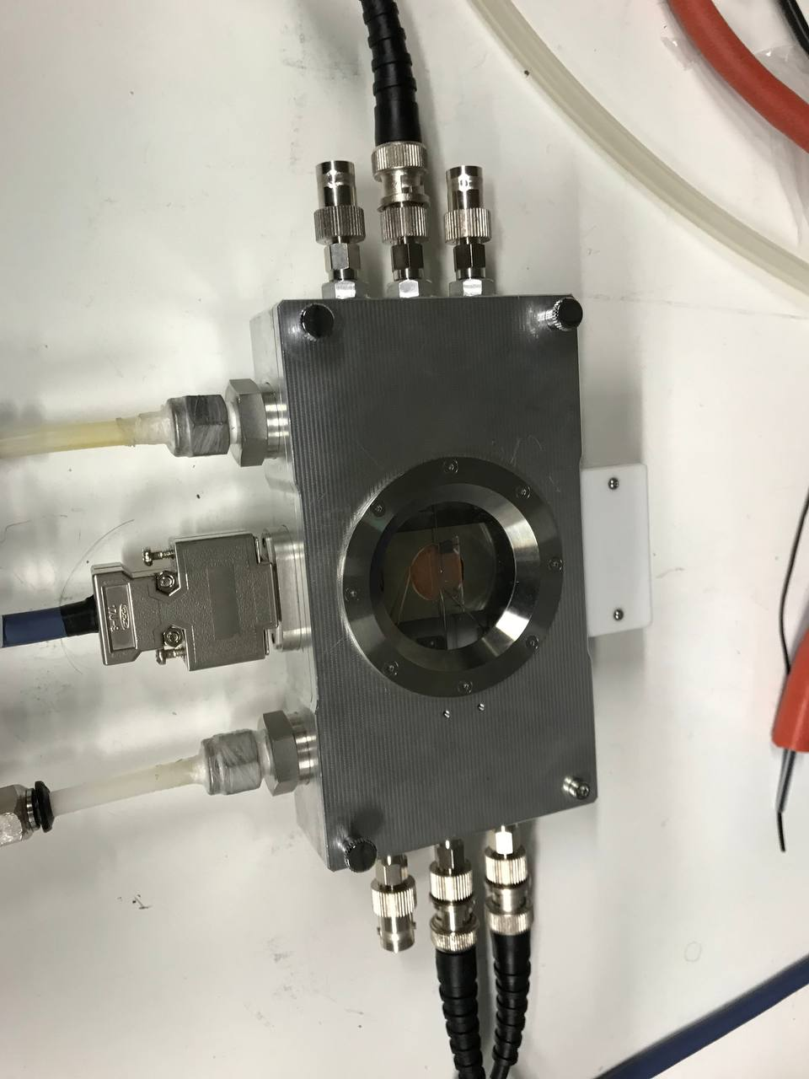
Experimental setup
(b)
(c)
(a)
(d)
Fig: (a) Experimental setup; (b) X-ray tube control unit; (c) SMU;
(d) Nextron box.

Slide 8
Calibration Plot (distance 32 cm from the chassis)

Slide 9
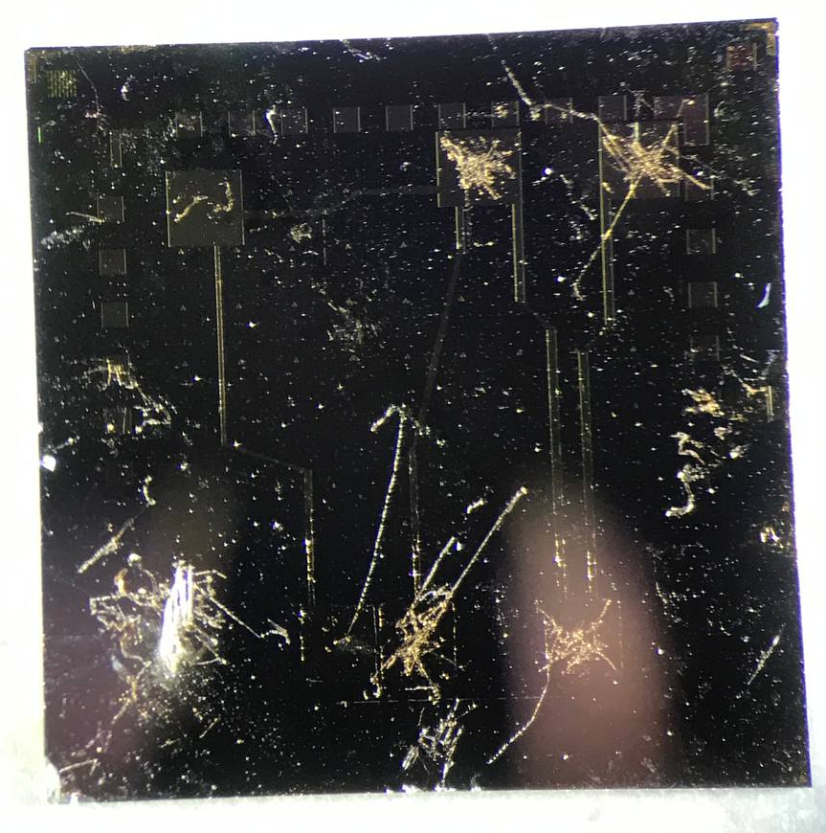
Sample1_device1
Device 3
Device 4
Device 1
Device 2
Device 5

Slide 10
Sample1_device1
IDrain shows no signal, probably, bad connection with Nextron.

Slide 11
Sample1_device3

Slide 12
Sample1_device3
The initial trfSat is good, the final one is also fine, however, the IGate shows significant leakage.

Slide 13
Sample1_device3
Long relaxation (high concentration of traps?).
When the X-ray radiation is ON, IDrain starts to sharply decrease, when X-rays are OFF, IDrain decreases more slowly.
At ITube=300uA the noise is too high.

Slide 14
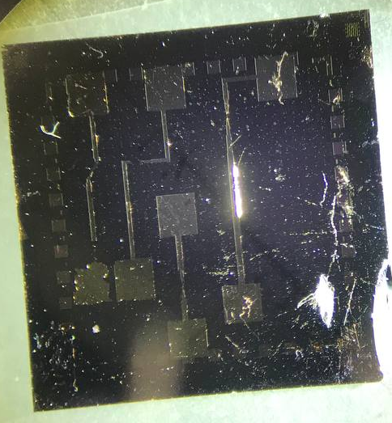
Sample4_device1
Device 4
Device 3
Device 2
Device 1

Slide 15
Sample4_device1
IDrain is almost zero, it seemed that the Au electrodes were too damaged.

Slide 16
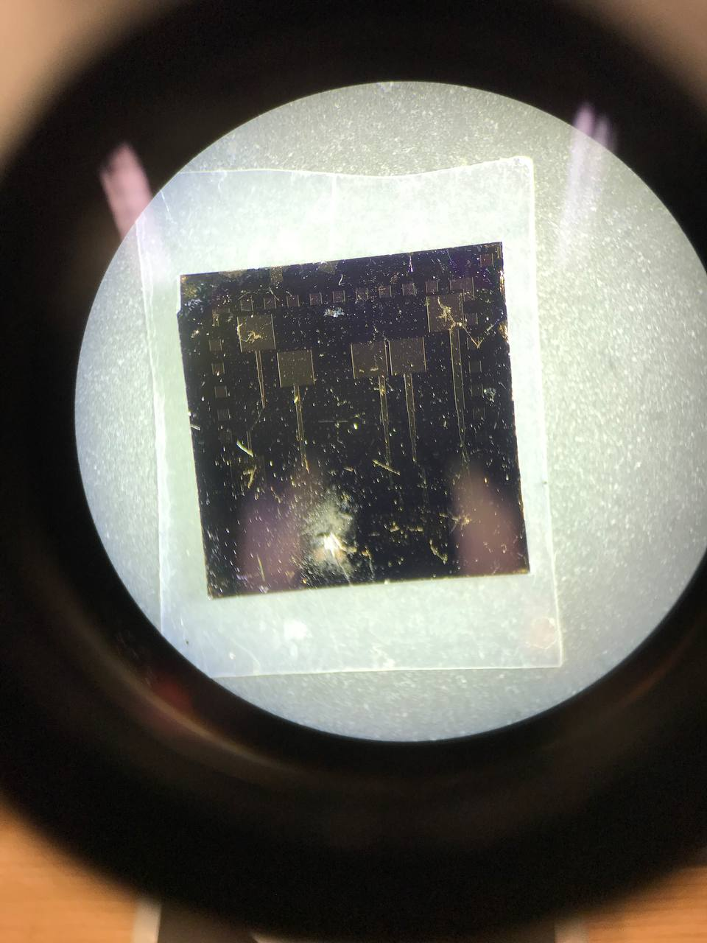
Sample6_device1
Device 3
Device 4
Device 2
Device 5

Slide 17
Sample6_device1
Initial and final trfSat are almost the same and have small hysteresis.

Slide 18
Sample6_device1
At high ITube, when the X-ray radiation is ON, IDrain starts to sharply decrease. When X-rays are OFF, IDrain decreases more slowly.
At ITube=200uA the tendency is lost.

Slide 19
Sample6_device5

Slide 20
Sample6_device5
The initial trfSat is relatively fine, significant hysteresis is present.
IDrain ∝ 10⁻⁶ A at VGate=20V.
At ITube=500uA the signal is already unseen, so I stopped the measurement and changed the sample.

Slide 21
Sample7_device1

Slide 22
Sample7_device1
At initial trfSat significant hysteresis is present.
IDrain ∝ 10⁻⁶ A at VGate=35V.
At ITube500uA the signal was already unseen, so I stopped the measurement and changed the sample. At first peak it is seen that IDrain decreases more sharply when X-ray radiation is ON.

Slide 23
Sample8_device1

Slide 24
Sample8_device1
The initial trfSat is realtively fine, significant hysteresis is present.
IDrain ∝ 10⁻⁶ A at VGate=22V.
At ITube=500uA the signal was already unseen, so I stopped the measurement and changed the sample.

Slide 25
Sample9_device3

Slide 26
Sample9_device3
SHORT CIRCUIT BETWEEN GATE AND DRAIN/SOURCE. Probably it was created by the silver paste intercalating through the insulator.

Slide 27
Sample10_device3

Slide 28
Sample10_device3
IDrain is almost zero, the trfSat was also verified in horizontal position. Probably, the Au electrodes were too damaged.

Slide 29
Sample10_device6

Slide 30
Sample10_device6
SHORT CIRCUIT BETWEEN THE DRAIN AND THE GATE. Probably it was caused by the silver paste intercalating in the insulator.

Slide 31
Sample11_device3

Slide 32
Sample11_device3
NO SENSE.

Slide 33
Sample12_device2

Slide 34
Sample12_device2
Significant hysteresis is present.
Drain current reaches microAmps only at 50V, which is too high voltage for reaching photoconductive gain.

Slide 35
Sample12_device3

Slide 36
Sample12_device3
Comments:
At initial trfSat significant hysteresis is present.
IDrain ∝ 10⁻⁶ A at VGate=25V.
When the X-ray radiation is ON, POSITIVE peaks in IDrain appear (unlike in previous samples).
To calculate the height of the peaks, each set of peaks was fitted with a normalizing function (polynomial of order 2, exponential or linear).
For each set of peaks the average photocurrent was calculated. After that the dependence of the average photocurrent on the dose rate (related to ITuber) was fitted with a linear function. The slope of the fit determined the sensitivity of the device.

Slide 37
Sample12_device3
Sensitivity/Volume (uC/(Gy*cm³)):
VGate=30V -> (3.8±0.2)*10¹¹
VGate=40V -> (3.1±1.0)*10¹¹
VGate=50V -> (-30±7)*10¹¹ NEGATIVE!
At VGate=30V the sensitivity is higher than at VGate=40V.
At VGate=50V the peaks start to decrease with increasing Dose rate (by increasing ITube). As a result, the sensitivity appears to be negative.

Slide 38
Sample12_device4

Slide 39
Sample12_device4
Initial trfSat is relatively fine, hysteresis is present.
IDrain ∝ 10⁻⁶ A at VGate=35 V.
Here the peaks also appear but they are NEGATIVE and bigger than in Sample12_device3.

Slide 40
Sample14_device1

Slide 41
Sample14_device1
Initial trfSat is relatively fine, small hysteresis is present.
IDrain ∝ 10⁻⁶ A at VGate=20V.
Some tendency is seen only at I_Tube=500uA, POSITIVE peaks appear.

Slide 42
Sample14_device2

Slide 43
Sample14_device2
Initial and final trfSat are quite good with small hysteresis.
IDrain ∝ 10⁻⁶ A at VGate=-2V.
At VGate=1V IDrain shows no tendency, when the radiation is ON, IDrain decreases more sharply than in the dark.

Slide 44
Sample14_device3

Slide 45
Sample14_device3
Both initial and the final trfSat have significant hysteresis.
IDrain ∝ 10⁻⁶ A at VGate=42V.
Peaks are present and POSITIVE but very small (∝10⁻⁹A) . Almost no noise.
At 40 V peaks were quite small (∝10⁻⁹A) already at ITube=500uA, so I stopped here and increased VGate to 50V.

Slide 46
Sample14_device3
Sensitivity/Volume (uC/(Gy*cm³)):
VGate=50V -> (6.5±0.7)*10¹¹
The magnitude of the sensitivity per unit volume is similar to Sample12_device3 at VGate=30V and 40V (at 50V the value is negative): ∝ 10¹¹ uC/(Gy*cm³).

Slide 47
Sample14_device4 (15/11)

Slide 48
Sample14_device4 (15/11)
Both initial and final trfSat are fine with almost no hysteresis.

Slide 49
Sample14_device4 (15/11)
At VGate=1V the peaks are POSITIVE, however, they diminish as ITube increases.
At VGate=2V large negative peaks appear. The same tendency happens at VGate=3V and 5V.

Slide 50
Sample14_device4 (22/11)

Slide 51
Sample14_device4 (22/11)
Initial trfSat is quite good with small hysteresis.
IDrain ∝ 10⁻⁶ A at VGate=-20V.
At VGate=-20V when the radiation is ON, IDrain starts to sharply decrease with no peaks but STEPS.
At VGate=1V IDrain starts to sharply decrease with almost no peaks or steps present.

Slide 52
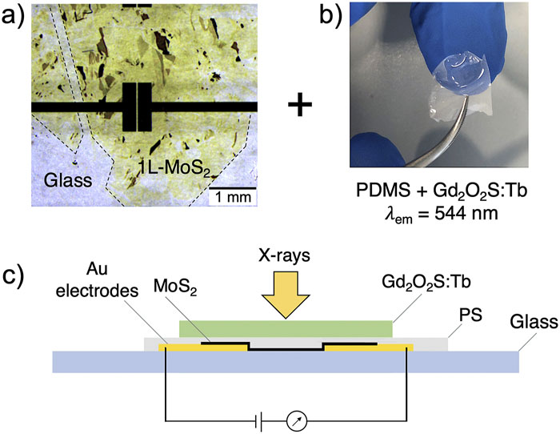
Comparison with the data from literature:
Alberto Taffelli, Max Heyl, Matteo Favaro, Sandra Dirè, Lucio Pancheri, Emil J. W. List-Kratochvil, Alberto Quaranta, Giovanni Ligorio; Demonstrating the high sensitivity of MoS₂ monolayers in direct x-ray detectors. APL Mater. 1 August 2023; 11 (8): 081101. https://doi.org/10.1063/5.0151794
Deposition method – exfoliation method
Polysterene (PS) film th ∝ 1 um
Au electrodes th = 100 nm
Active channel area = 0.03 mm²
Active channel th = 0.9 nm
Fig: A schematic cross-section of the final device exposed to x ray and connected to an external source meter unit.
Main parameters:
Sensitivity/volume = 10⁸ – 10⁹ uC/(Gy*cm³)
Sensitivity/area = 10 – 100 uC/(Gy*cm²)
Results from Batch2 (S12_d3 and S14_d3):
S12_d3 Sensitivity/volume = (3.8±0.2)*10^11 uC/(Gy*cm³) (VGate=30V)
S12_d3 Sensitivity/volume = (3.1±1.0)*10^11 uC/(Gy*cm³) (VGate=40V)
S14_d3 Sensitivity/volume = (6.5±0.7)*10^11 uC/(Gy*cm³) (VGate=50V)

